Slide 1
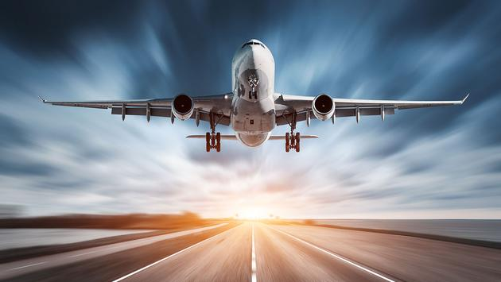
DELAYED FLIGHTS ANALYSIS
Mini Project 1
By Catriona Hodges
08 August 2020

Slide 2
AGENDA
1
PROJECT CONTEXT
2
BUSINESS QUESTION
3
DATA ANALYSIS
4
MODELLING
5
DELIVER
6
CONCLUSION
NEXT STEPS
SUMMARY

Slide 3
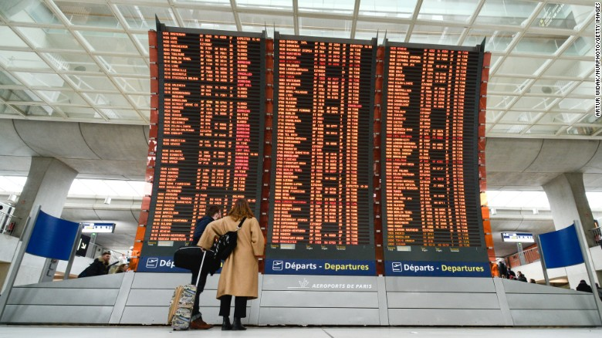
PROJECT CONTEXT
Every day thousands of flights are delayed or cancelled around the world.
In the USA alone, almost 6 MILLION flights were delayed or cancelled in the year 2015!
Delays are not only frustrating for passengers, but costly to airlines.

Slide 4
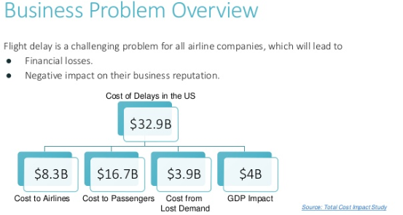
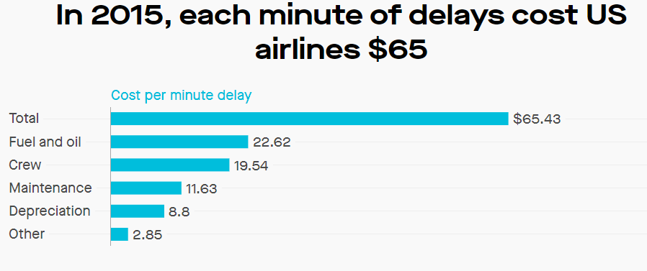
COSTS OF DELAYS TO AIRLINES
Flight delays cost airlines over 8 billion dollars per year!
In 2015 the average cost of delays for airlines was $65 per minute!
Source:- https://www.slideshare.net/HaozheWang/airline-flights-delay-predicton
Source:- https://theatlas.com/charts/ryere38D

Slide 5
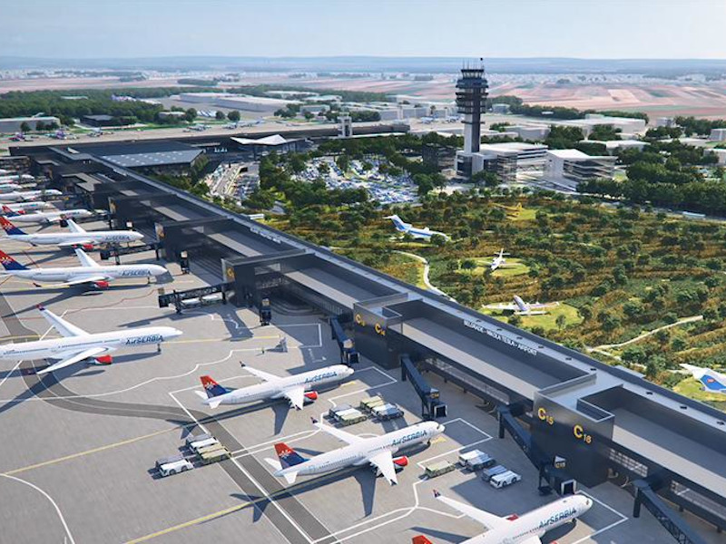
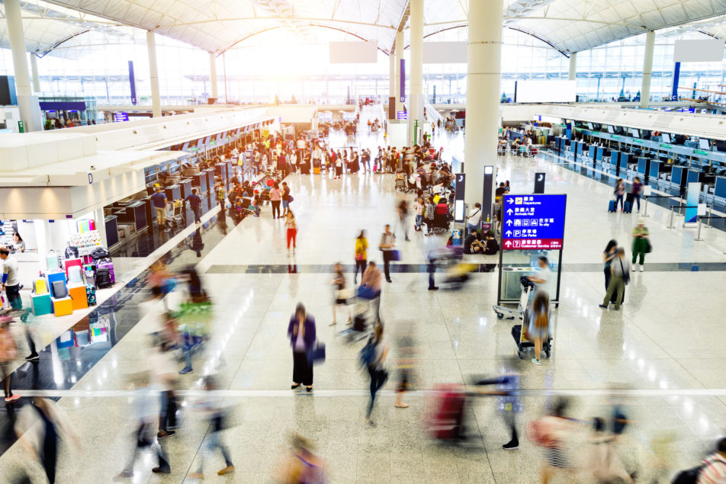
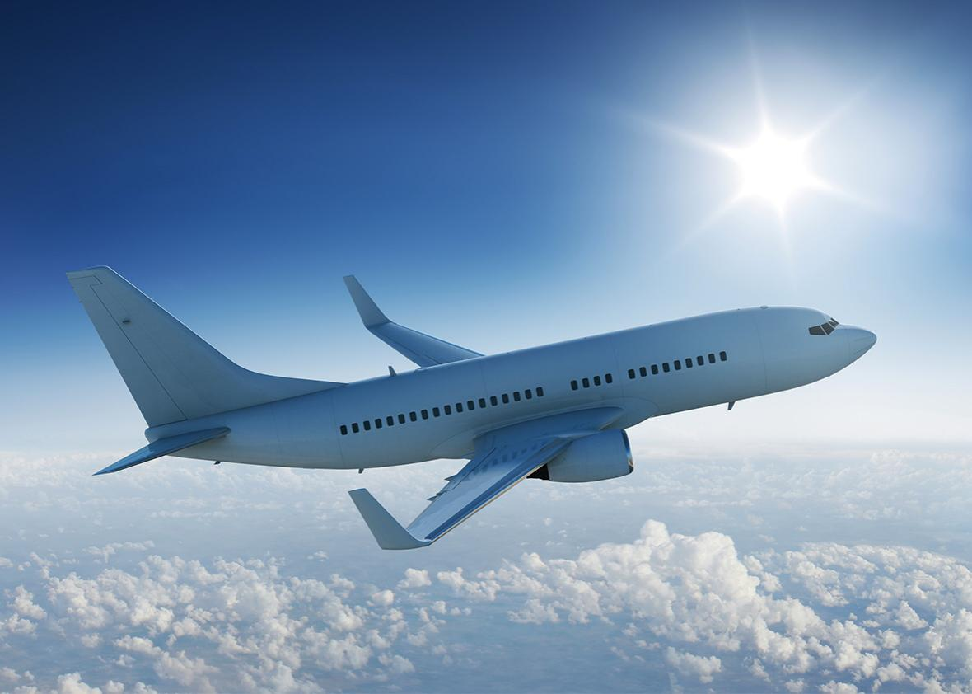
Using data from delayed flights in the USA during 2015, the aim is to establish the main reasons for these delays and how performance can be improved.
BUSINESS QUESTION
WHAT ARE THE MAIN CAUSES OF FLIGHT DELAYS ?
CLIENT: – SOUTH WEST AIRLINES

Slide 6



pipeline
STAKEHOLDERS
Business
Question
Business Answer
Data Answer
Data Question
Solution
DATA
Data Analysis & Feature Selection
Modelling &
Validation

Slide 7
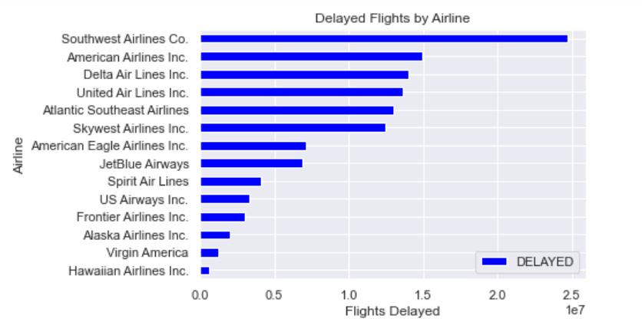

WHICH AIRLINE HAS THE MOST DELAYED FLIGHTS?
Analysing first which airlines have the most delays and how South West Airlines compares..

Slide 8
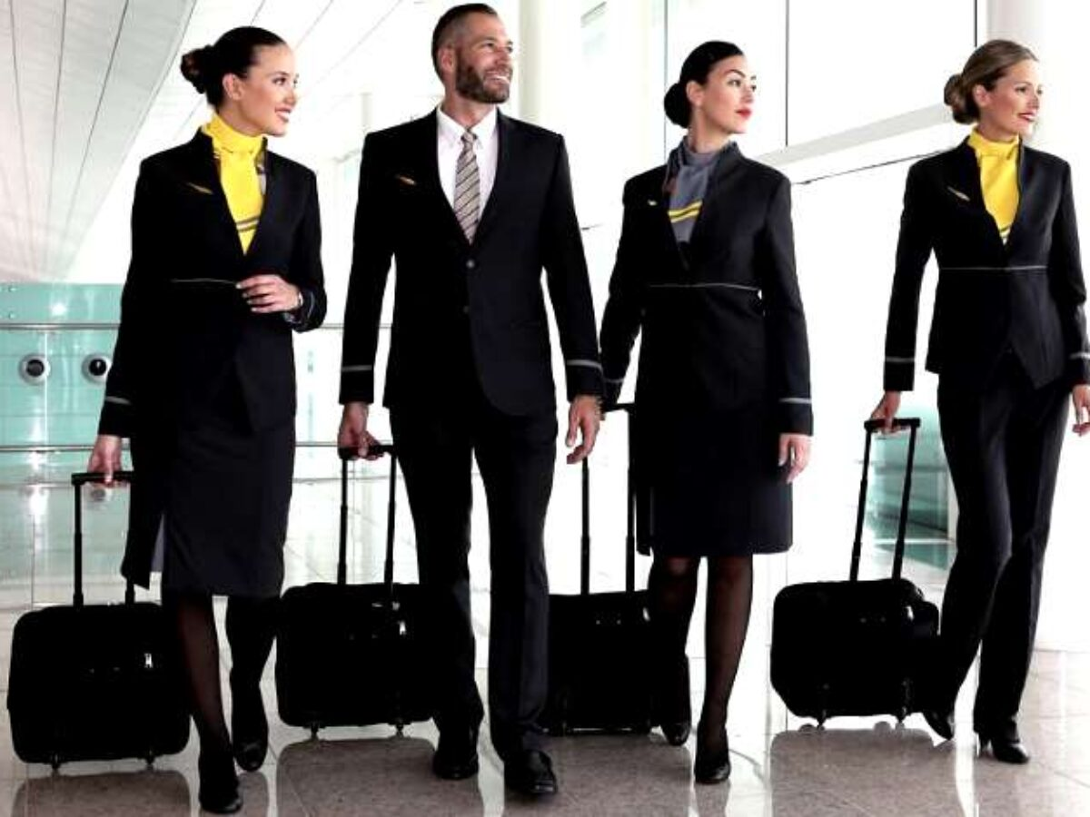
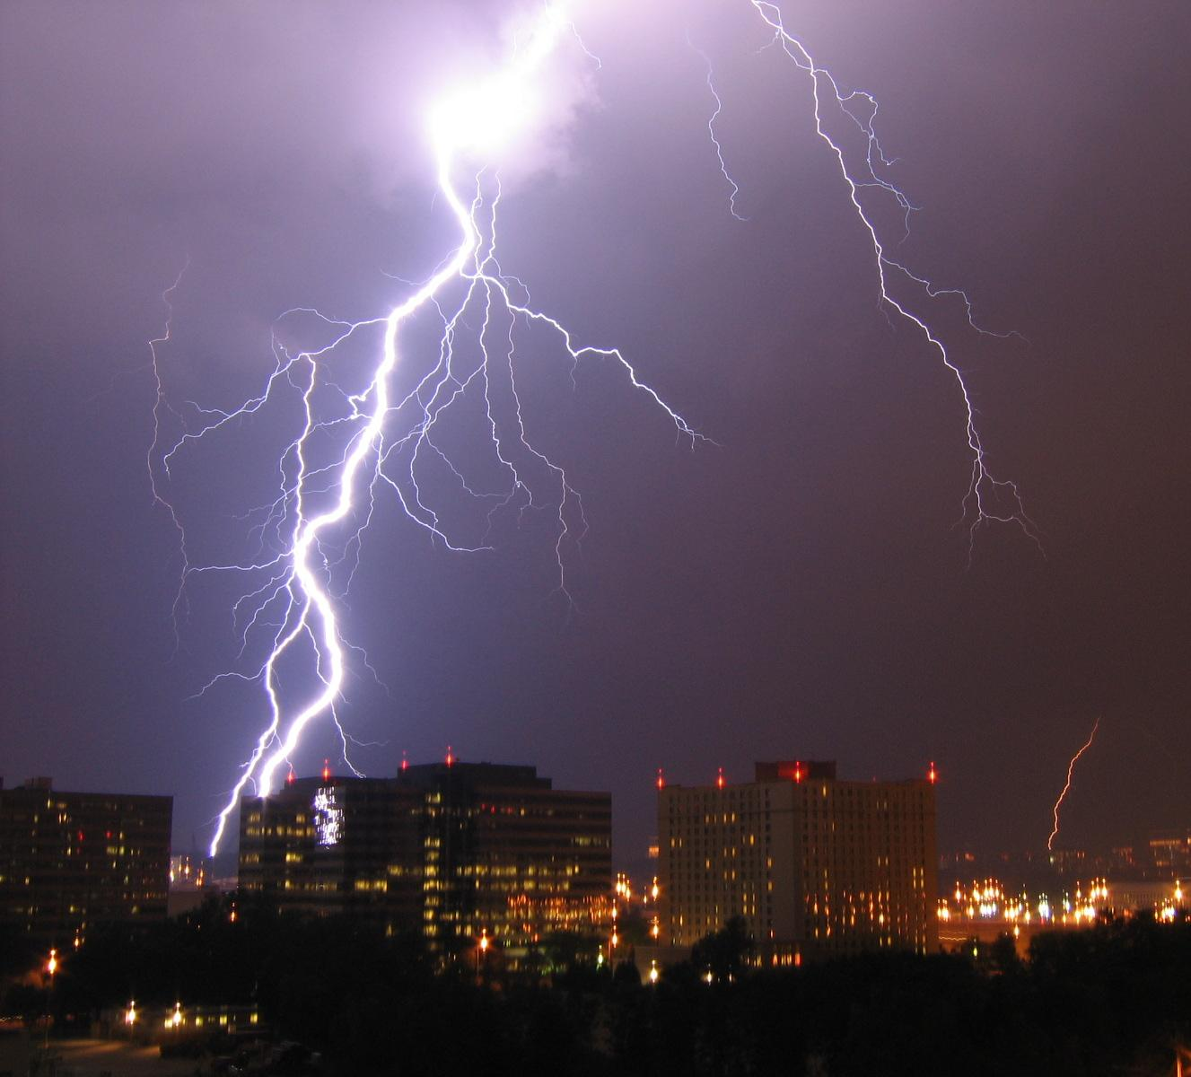
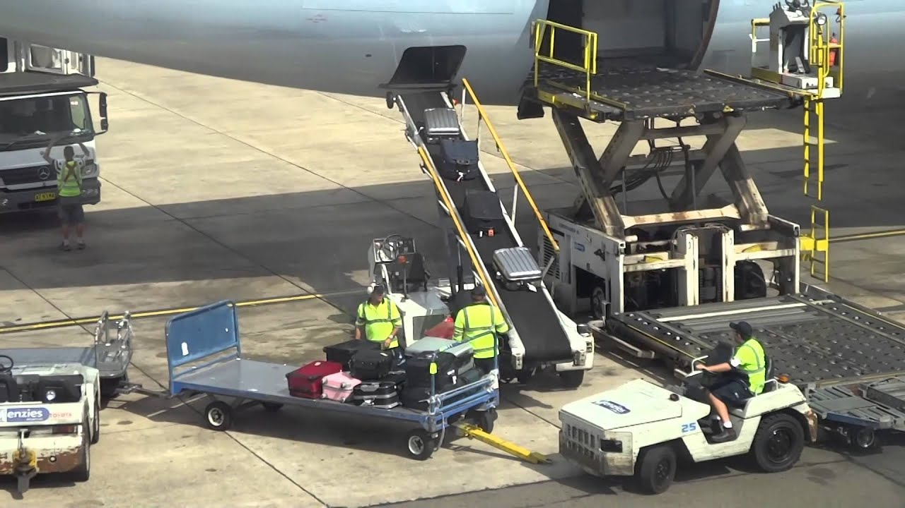

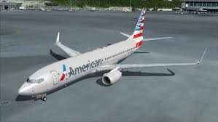
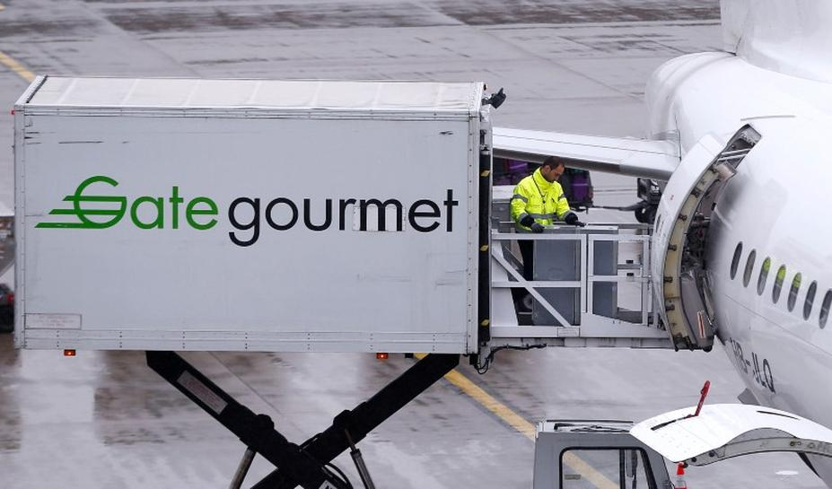
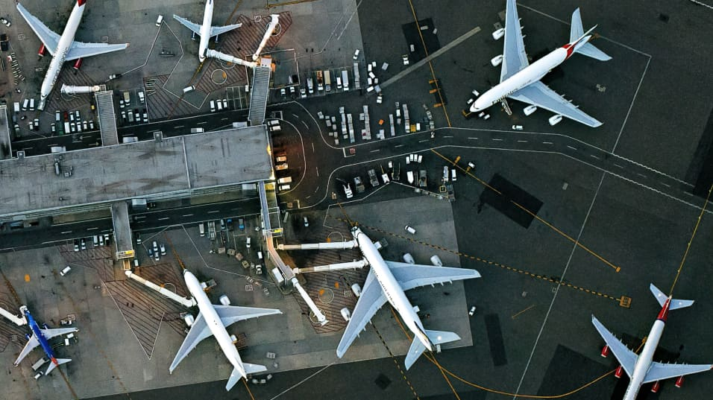
WHAT COULD BE CAUSING THE DELAYS?
Weather?
Cabin crew late
or sick?
Baggage handlers?
Problem with airplane?
Late aircraft arrival?
Caterers?

Slide 9

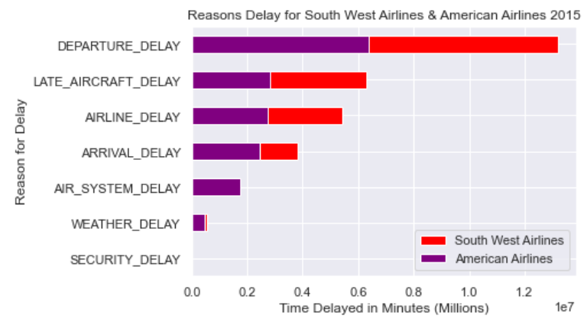
COMPARE REASONS FOR DELAY
FOR SOUTH WEST vs AMERICAN AIRLINES
Comparison between reasons for delay between South West Airlines and next worst performing airline, American Airlines.

Slide 10

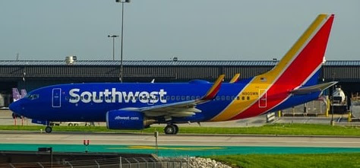
CORRELATIONS
There is strong correlation between:
* Departure Delay & Arrival Delay (0.98)
* Late Aircraft Delay & Departure Delay (0.55)
* Arrival Delay & Late Aircraft Delay (0.52)
DEPARTURE
DELAY
ARRIVAL
DELAY
LATE AIRCRAFT
DELAY
It seems there could be a rolling effect that one may lead to another!

Slide 11
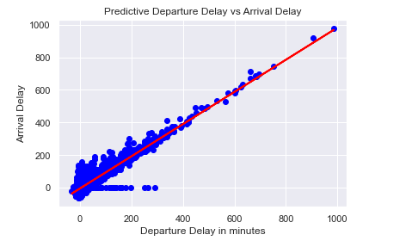
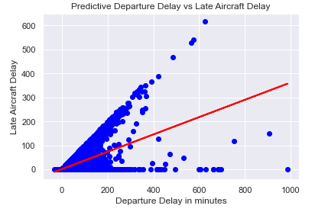
SUMMARY
DATA | APPROACH | OUTCOMES
5,819,079 records of flight delays in 2015 for USA | Feature selection narrowed down from 31 features | Linear Regression used to compare and confirm predictions
Target variable “Departure Delays” | Focus on Airline – South West Airlines Departure Delay Arrival Delay Late Aircraft Delay
31 Features -Airline -Date -Arrival Time -Arrival Delay -Airport -Distance in Air……. | Use these features to analyse causes delays and correlations between features.

Slide 12
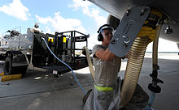

CONCLUSION
Recommendation is for further analysis into ground operations between flight arrival and departure for South West Airlines.
This could include efficiencies in operations of:-
Luggage handling
Catering loading
Refuelling systems
Cabin Crew arrival
Check in operations

Slide 13
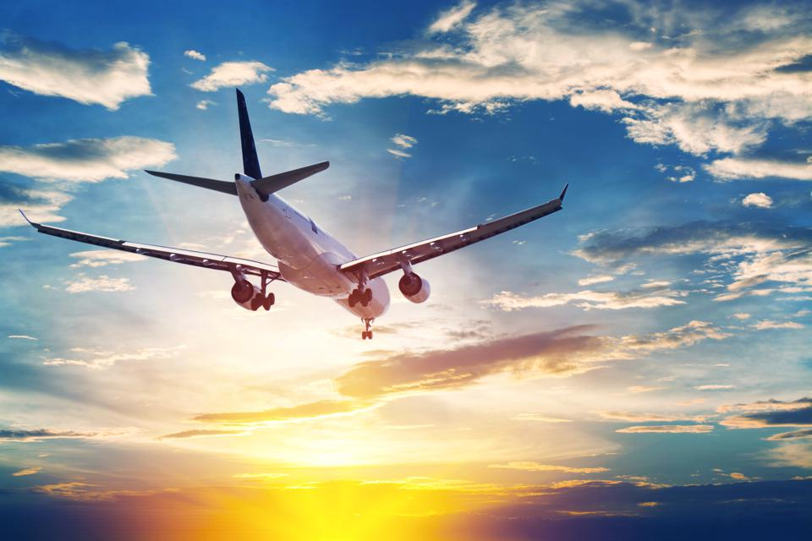
THANKYOU!

